Slide 1
Software Design Patterns
Paddy Matthews

Slide 2
Mediator Pattern

Slide 3
Mediator Pattern
The Mediator pattern defines an object that encapsulates the interactions between a set of objects
  It promotes loose coupling by keeping objects from explicitly referring to each other.
  It lets you vary the objects' interaction independently.

Slide 4
Mediator Pattern
Object-oriented design encourages the distribution of behaviour among objects.
This can result in an object structure with many connections between objects – in the worst-case scenario, every object ends up knowing about every other object.
Although partitioning a system into many objects generally enhances reusability, the increase in interconnections counteracts the improvement.
The increase in interconnections make it less likely that an object can work without the support of others, and the system acts as though it were monolithic.
It also makes it difficult to change the system's behaviour in any significant way when that behaviour is distributed among many objects.
As a result, we may be forced to define many subclasses to allow the system's behaviour be customised.

Slide 5
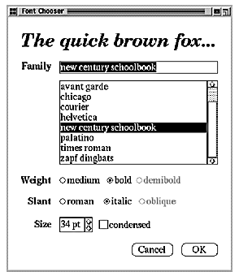
Mediator Pattern Example
An example of its use might be a collection of UI widgets such as dialog boxes that interact with one another.
  e.g., certain families of fonts may not have certain weights
    the 'demibold' choice might need to be disabled for particular values

Slide 6
Mediator Pattern Example
There may be complex dependencies between the components in the dialog based on their meanings:
  a button needs to be disabled when a certain entry field is empty or vice versa.
  selecting an entry in a list box might cause the contents of an entry field to change.
  typing text into the entry field might automatically select one or more corresponding entries in the list box.
  once text appears in the entry field, other buttons may become enabled that let the user do something with the text, such as changing or deleting the item to which it refers.

Slide 7
Mediator Pattern Example
Different dialog boxes will have different dependencies between components, so even though dialogs display the same kinds of components, they can't simply reuse component classes, but instead must customise the component classes to reflect dialog-specific dependencies.
However, customising components individually by subclassing will be tedious, since many classes are involved.

Slide 8
Mediator Pattern Example
We can avoid these problems by encapsulating the collective behaviour in a separate mediator object.
A mediator is responsible for controlling and coordinating the interactions of a group of objects.
It serves as an intermediary that prevents objects in the group from having to explicitly refer to each other.
Instead, the objects only have to know about the mediator, thereby reducing the number of interconnections.

Slide 9
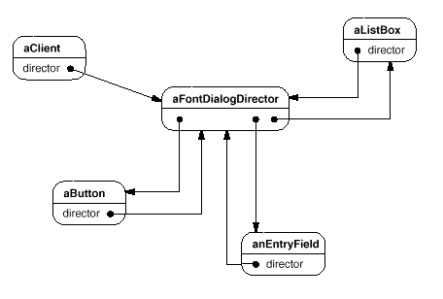
Mediator Pattern Example
We can create a Mediator object to control and co-ordinate the actions of a group of objects.
For example, FontDialogDirector might be the mediator between the components in a dialog box, with an object of the mediator class knowing the components in a dialog and coordinating their interaction, to allow it to act as a communication hub:

Slide 10
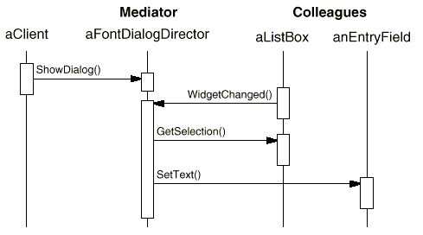
Mediator Pattern Example
Sequence diagram showing how objects might co-operate in a list box selection:

Slide 11
Mediator Pattern Example
Sequence of events on the previous slide:
  The list box tells its director that it's changed.
  The director gets the selection from the list box.
  The director passes the selection to the entry field.
  Now that the entry field contains some text, the director can enable button(s) for initiating an action (e.g., "demibold," "oblique").
We can see how the director mediates between the list box and the entry field.
Components only communicate with each other indirectly through the director.
They don't have to know about each other; all that each needs to know is the director.
Because the behaviour is now localised in one mediator class, it can be changed or replaced by extending or replacing that class.

Slide 12
Mediator Pattern Example
The diagram on the next slide shows how the FontDialogDirector abstraction can be integrated into a class library.
DialogDirector is an abstract class that defines the overall behaviour of a dialog.
Clients call the showDialog operation to display the dialog on the screen.
createWidgets is an abstract operation for creating the components of a dialog.
widgetChanged is another abstract operation called by components to inform their director that they have changed.
DialogDirector subclasses override createWidgets to create the approporiate components, and override widgetChanged to handle the changes.

Slide 13
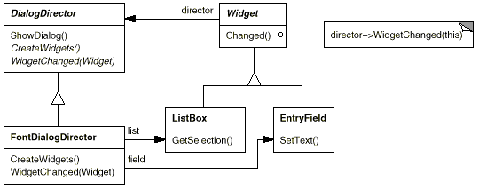
Mediator Pattern Example
URL diagram:

Slide 14
Mediator Pattern
The Mediator pattern is applicable where:
  A set of objects communicate in a well-defined but complex manner, so that the resulting interdependencies are unstructured and difficult to understand.
  Reusing an object is difficult because it refers to and communicates with many other objects.
  A behaviour that's distributed between several classes should be customisable without requiring a lot of subclassing.

Slide 15
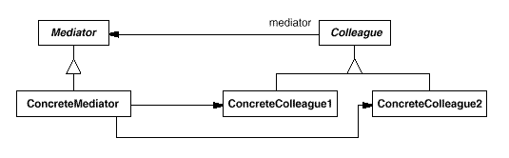
Mediator Pattern
UML diagram:

Slide 16
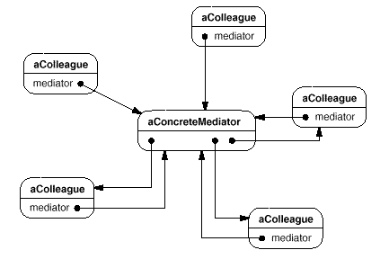
Mediator Pattern
Typical object structure diagram:

Slide 17
Mediator Pattern
Participants:
  Mediator
    defines an interface for communicating with Colleague objects.
  ConcreteMediator
    implements cooperative behaviour by coordinating Colleague objects.
    knows and maintains its colleagues.
  Colleague classes
    each Colleague class knows its Mediator object.
    each colleague communicates with its mediator whenever it would have otherwise communicated with another colleague.
Collaborations
  Colleagues send and receive requests from a Mediator object.
  The mediator implements the Mediator cooperative behaviour by routing requests between the appropriate colleague(s).

Slide 18
Mediator Pattern
Consequences
  The Mediator pattern has the following benefits and drawbacks:
    It limits subclassing.
      A mediator localises behaviour that otherwise would be distributed among several objects.
      Changing this behaviour only requires subclassing Mediator; the Colleague classes can be reused without change.
    It decouples colleagues.
      A mediator promotes loose coupling between colleagues.
      You can vary and reuse Colleague and Mediator classes independently.
    It simplifies object protocols.
      A mediator replaces many-to-many interactions with one-to-many interactions between the mediator and its colleagues.
      One-to-many relationships are easier to understand, maintain, and extend.

Slide 19
Mediator Pattern
Consequences
  The Mediator pattern has the following benefits and drawbacks:
    It abstracts how objects cooperate.
      Making mediation an independent concept and encapsulating it in an object allows us to focus on how objects interact apart from their individual behaviour, and this can help clarify how objects interact in a system.
    It centralises control.
      The Mediator pattern trades complexity of interaction between objects for complexity within the mediator.
      Because a mediator encapsulates protocols, it can become more complex than any individual colleague.
      This can make the mediator itself a monolith that's hard to maintain.

Slide 20
Mediator Pattern
Implementation issues
  The following implementation issues are relevant to the Mediator pattern:
    Omitting the abstract Mediator class.
      There's no need to define an abstract Mediator class when colleagues work with only one mediator.
      The abstract coupling that the Mediator class provides lets colleagues work with different Mediator subclasses, and vice versa.
    Colleague-Mediator communication.
      Colleagues have to communicate with their mediator when an event of interest occurs.
      One approach is to implement the Mediator as an Observer.
        Colleague classes act as Subjects, sending notifications to the mediator whenever they change state.
        The mediator responds by propagating the effects of the change to other colleagues.

Slide 21
Mediator Pattern
Implementation issues
  The following implementation issues are relevant to the Mediator pattern:
    Colleague-Mediator communication.
      Colleagues have to communicate with their mediator when an event of interest occurs.
      Another approach defines a specialised notification interface in Mediator that lets colleagues be more direct in their communication.
        A form of delegation might be used: when communicating with the mediator, a colleague passes itself as an argument, allowing the mediator to identify the sender.

Slide 22
Mediator Pattern
Related Patterns
  Facade differs from Mediator in that it abstracts a subsystem of objects to provide a more convenient interface.
    Its protocol is unidirectional; Facade objects make requests of the subsystem classes but not vice versa.
    In contrast, Mediator enables cooperative behaviour that colleague objects don't or can't provide, and the protocol is multidirectional.
  Colleagues can communicate with the mediator using the Observer pattern.

Slide 23
Mediator Pattern Example
A possible application for the Mediator pattern might be a chatroom.
We begin by defining the Mediator interface:
//Mediator interface
public interface Mediator {
public void send(String message, Colleague colleague);
}

Slide 24
Mediator Pattern Example
Now we can set up Colleague as an abstract class:
//Colleague interface
public abstract Colleague {
private Mediator mediator;
public Colleague(Mediator m) {
mediator = m;
}
//send a message via the mediator
public void send(String message) { mediator.send(message, this); }
//get access to the mediator
public Mediator getMediator() { return mediator; }
public abstract void receive(String message);
}

Slide 25
Mediator Pattern Example
Now we can define the concrete implementation of our Mediator:
public class ApplicationMediator implements Mediator {
private ArrayList<Colleague> colleagues;
public ApplicationMediator() { colleagues = new ArrayList<Colleague>(); }
public void addColleague(Colleague colleague) { colleagues.add(colleague); }
public void send(String message, Colleague originator) {
//let all other screens know that this screen has changed
for (Colleague colleague: colleagues) {
//don't tell ourselves
if(colleague != originator) {
colleague.receive(message);
}
}
}
}

Slide 26
Mediator Pattern Example
We could define multiple concrete implementations of the Colleague:
public class ConcreteColleague extends Colleague {
public void receive(String message) {
System.out.println("Colleague Received: " + message);
}
}
public class MobileColleague extends Colleague {
public void receive(String message) {
System.out.println("Mobile Received: " + message);
}
}

Slide 27
Mediator Pattern Example
In our next example, we will create a Mediator class (without implementing a Mediator interface).
This mediator will mediate the communication between:
  two buyers (a Swedish buyer and a French buyer),
  an American seller,
  and a currency converter.
The Mediator has references to the two buyers, the seller, and the converter.
It has methods that allow objects of these types to be registered.
It also has a placeBid() method which takes a bid amount and a unit of currency as parameters, then converts this amount to a dollar amount via communication with the DollarConverter, asks the seller if the bid has been accepted, and then returns the answer.

Slide 28
Mediator Pattern Example
This is the code for the mediator:
public class Mediator {
Buyer swedishBuyer; Buyer frenchBuyer;
AmericanSeller americanSeller; DollarConverter dollarConverter;
public Mediator() {}
public void registerSwedishBuyer(SwedishBuyer swedishBuyer) {
this.swedishBuyer = swedishBuyer;
}
public void registerFrenchBuyer(FrenchBuyer frenchBuyer) {
this.frenchBuyer = frenchBuyer;
}
public void registerAmericanSeller(AmericanSeller americanSeller) {
this.americanSeller = americanSeller;
}
/* continued on next slide */

Slide 29
Mediator Pattern Example
This is the code for the mediator:
/* continued from previous slide */
public void registerDollarConverter(DollarConverter dollarConverter) {
this.dollarConverter = dollarConverter;
}
public boolean placeBid(float bid, String unitOfCurrency) {
float dollarAmount =
dollarConverter.convertCurrencyToDollars(bid, unitOfCurrency);
return americanSeller.isBidAccepted(dollarAmount);
}
}

Slide 30
Mediator Pattern Example
The Buyer class has a unit of currency as a field, as well as a reference to the mediator.
It has an attemptToPurchase() method which submits a bid to the mediator's placeBid() method and returns the mediator's response.
SwedishBuyer and FrenchBuyer are subclasses of Buyer.
public class Buyer {
Mediator mediator; String unitOfCurrency;
public Buyer(Mediator mediator, String unitOfCurrency) {
this.mediator = mediator;
this.unitOfCurrency = unitOfCurrency;
}
public boolean attemptToPurchase(float bid) {
System.out.println("Buyer attempting a bid of " + bid + " " +
unitOfCurrency);
return mediator.placeBid(bid, unitOfCurrency);
}
}

Slide 31
Mediator Pattern Example
These are SwedishBuyer and FrenchBuyer:
public class FrenchBuyer extends Buyer {
public FrenchBuyer(Mediator mediator) {
super(mediator, "euro");
this.mediator.registerFrenchBuyer(this);
}
}
public class SwedishBuyer extends Buyer {
public SwedishBuyer(Mediator mediator) {
super(mediator, "krona");
this.mediator.registerSwedishBuyer(this);
}
}

Slide 32
Mediator Pattern Example
In the constructor of the AmericanSeller class, the class gets a reference to the mediator and the value of priceInDollars is set, representing the price of some good being sold.
The seller registers with the mediator as the AmericanSeller.
The seller's isBidAccepted() method takes a bid (in dollars).
  If the bid is over the price (in dollars), the bid is accepted and true is returned.
  Otherwise, false is returned.

Slide 33
Mediator Pattern Example
Code for AmericanSeller:
public class AmericanSeller {
Mediator mediator; float priceInDollars;
public AmericanSeller(Mediator mediator, float priceInDollars) {
this.mediator = mediator; this.priceInDollars = priceInDollars;
this.mediator.registerAmericanSeller(this);
}
public boolean isBidAccepted(float bidInDollars) {
if (bidInDollars >= priceInDollars) {
System.out.println("Seller accepts the bid of " + bidInDollars + "
dollars\n");
return true;
}
else {
System.out.println("Seller rejects the bid of " + bidInDollars + "
dollars\n");
return false;
}
}
}

Slide 34
Mediator Pattern Example
The DollarConverter class is another colleague class.
When created, it gets a reference to the mediator and registers itself with the mediator as the DollarConverter.
This class has methods to convert amounts in euros and kronor to dollars.

Slide 35
Mediator Pattern Example
Code for DollarConverter:
public class DollarConverter {
Mediator mediator;
public static final float DOLLAR_UNIT = 1.0f;
public static final float EURO_UNIT = 0.7f;
public static final float KRONA_UNIT = 8.0f;
public DollarConverter(Mediator mediator) {
this.mediator = mediator;
mediator.registerDollarConverter(this);
}
private float convertEurosToDollars(float euros) {
float dollars = euros * (DOLLAR_UNIT / EURO_UNIT);
System.out.println("Converting " + euros + " euros to " +
dollars + " dollars"); return dollars;
}
/* continued on next slide */

Slide 36
Mediator Pattern Example
Code for DollarConverter:
/* continued on next slide */
private float convertKronorToDollars(float kronor) {
float dollars = kronor * (DOLLAR_UNIT / KRONA_UNIT);
System.out.println("Converting " + kronor + " kronor to " +
dollars + " dollars");
return dollars;
}
public float convertCurrencyToDollars(float amount, String unitOfCurrency) {
if ("krona".equalsIgnoreCase(unitOfCurrency)) {
return convertKronorToDollars(amount);
}
else {
return convertEurosToDollars(amount);
}
}
}

Slide 37
Mediator Pattern Example
The MediatorDemo class demonstrates our mediator pattern.
It creates a SwedishBuyer object and a FrenchBuyer object, and then creates an AmericanSeller object with a selling price set to 10 dollars, and a DollarConverter object.
All of these objects register themselves with the mediator in their constructors.
The Swedish buyer starts with a bid of 55 kronor and keeps bidding up in increments of 15 kronor until the bid is accepted.
The French buyer starts bidding at 3 euros and keeps bidding in increments of 1.50 euros until the bid is accepted.

Slide 38
Mediator Pattern Example
MediatorDemo code:
public class Demo {
public static void main(String[] args) {
Mediator mediator = new Mediator();
Buyer swedishBuyer = new SwedishBuyer(mediator);
Buyer frenchBuyer = new FrenchBuyer(mediator);
float sellingPriceInDollars = 10.0f;
AmericanSeller americanSeller =
new AmericanSeller(mediator, sellingPriceInDollars);
DollarConverter dollarConverter = new DollarConverter(mediator);
float swedishBidInKronor = 55.0f; float frenchBidInEuros = 3.0f;
while (!swedishBuyer.attemptToPurchase(swedishBidInKronor)) {
swedishBidInKronor += 15.0f;
}
while (!frenchBuyer.attemptToPurchase(frenchBidInEuros)) {
frenchBidInEuros += 1.5f;
}
}
}

Slide 39
Template Method Pattern

Slide 40
Template Method Pattern
The Template Method pattern designs the skeleton of an algorithm in an operation, deferring some steps to client subclasses.
Template Method lets subclasses redefine certain steps of an algorithm without changing the algorithm's overall structure.
The base class declares algorithm 'placeholders', and derived classes provide implementations for the placeholders.
The pattern might be used if we have two different components that have significant similarities, but demonstrate no reuse of a common interface or implementation.
If a change common to both components becomes necessary, duplicate effort must be expended to implement the change separately in both components.

Slide 41
Template Method Pattern
The component designer decides which steps of an algorithm are invariant (or standard), and which are variant (or customisable).
The invariant steps are implemented in an abstract base class, while the variant steps are either given a default implementation, or no implementation at all.
The variant steps represent hooks, or placeholders, that can, or must, be supplied by the component's client in a concrete derived class.
The component designer mandates the required steps of an algorithm, and the ordering of the steps, but allows the component client to extend or replace some number of these steps.

Slide 42
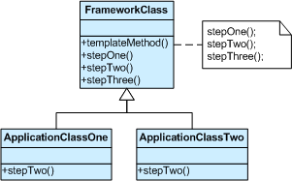
Template Method Pattern
UML diagram:
The implementation of template_method() is:
  call step_one(),
  call step_two(), and
  call step_three().
step_two() is a "hook" method – a placeholder.
It is declared in the base class, and then defined in derived classes.

Slide 43
Template Method Pattern
Template Method is used prominently in frameworks.
Each framework implements the invariant pieces of a domain's architecture, and defines "placeholders" for all necessary or interesting client customisation options.
In so doing, the framework becomes the "center of the universe", and the client customisations are simply "the third rock from the sun".
This inverted control structure has been affectionately labelled "the Hollywood principle" – "don't call us, we'll call you".

Slide 44
Template Method Pattern
Consider an application framework that provides Application and Document classes.
The Application class is responsible for opening existing documents stored in an external format, such as a file.
A Document object represents the information in a document once it's read from the file.
Applications built with the framework can subclass Application and Document to suit specific needs.
For example, a drawing application might define DrawApplication and DrawDocument subclasses, whereas a spreadsheet application might define SpreadsheetApplication and SpreadsheetDocument subclasses.

Slide 45
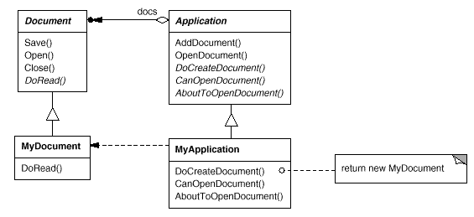
Template Method Pattern
UML diagram:

Slide 46
Template Method Pattern
The abstract Application class defines the algorithm for opening and reading a document in its openDocument operation.
openDocument defines each step for opening a document, such as:
  checking if the document can be opened,
  creating the application-specific Document object,
  adding it to its set of documents, and
  reading the Document from a file.
We call openDocument a template method.

Slide 47
Template Method Pattern
A template method defines an algorithm in terms of abstract operations that subclasses override to provide concrete behaviour.
Application subclasses define the steps of the algorithm that check if the document can be opened (canOpenDocument) and that create the Document (doCreateDocument).
Document classes define the step that reads the document (doRead).
The template method also defines an operation that lets Application subclasses know when the document is about to be opened (aboutToOpenDocument), in case they care.
By defining some of the steps of an algorithm using abstract operations, the template method fixes their ordering, but it lets Application and Document subclasses vary those steps to suit their needs.

Slide 48
Template Method Pattern
Template Method should be used:
  to implement the invariant parts of an algorithm once and leave it up to subclasses to implement the behaviour that can vary.
  when common behaviour among subclasses should be factored and localised in a common class to avoid code duplication.
    This is an example of "refactoring to generalise".
      You first identify the differences in the existing code and then separate the differences into new operations.
      Finally, you replace the differing code with a template method that calls one of these new operations.
  to control subclasses extensions.
    You can define a template method that calls "hook" operations at specific points, thereby permitting extensions only at those points.

Slide 49
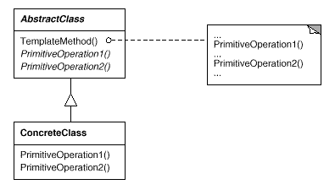
Template Method Pattern
UML diagram:

Slide 50
Template Method Pattern
Participants:
  AbstractClass
    defines abstract primitive operations that concrete subclasses will define in order to implement steps of an algorithm.
    implements a template method defining the skeleton of an algorithm.
      The template method can call these primitive operations as well as operations defined in AbstractClass or those of other objects.
  ConcreteClass
    implements the primitive operations to carry out subclass-specific steps of the algorithm.
Collaborations:
  ConcreteClass relies on AbstractClass to implement the invariant steps of the algorithm.

Slide 51
Template Method Pattern
Consequences:
  Template methods are a fundamental technique for code reuse.
    They are particularly important in class libraries, because they are the means for factoring out common behaviour in library classes.
    Template methods lead to an inverted control structure where a parent class calls the operations of a subclass and not the other way around.
  Template methods call the following kinds of operations:
    concrete operations (either on the ConcreteClass or on client classes);
    concrete AbstractClass operations (i.e., operations that are generally useful to subclasses);
    primitive operations (i.e., abstract operations);
    factory methods; and
    hook operations, which provide default behaviour that subclasses can extend if necessary, although a hook operation often does nothing by default.

Slide 52
Template Method Pattern
Consequences:
  It's important for template methods to specify which operations are hooks (may be overridden) and which are abstract operations (must be overridden).
    To reuse an abstract class effectively, subclass writers must understand which operations are designed for overriding.
  A subclass can extend a parent class operation's behaviour by overriding the operation and calling the parent operation explicitly.
    Unfortunately, it's easy to forget to call the inherited operation.
    We can transform such an operation into a template method to give the parent control over how subclasses extend it.
    The idea is to call a hook operation from a template method in the parent class, which subclasses can then override.

Slide 53
Template Method Pattern
Related Patterns
  Factory Method: factory methods are often called by template methods.
  Strategy:
    Template methods use inheritance to vary part of an algorithm.
    Strategies use delegation to vary the entire algorithm.

Slide 54
Template Method Pattern Example
An example of the use of the Template Method pattern would be to create a cross compiler.
First, we'll create a generic cross compiler base class, with a crossCompile() method as the glue for the whole algorithm to run:
public abstract class CrossCompiler {
public final void crossCompile() {
collectSource();
compileToTarget();
}
//Template methods
protected abstract void collectSource();
protected abstract void compileToTarget();
}

Slide 55
Template Method Pattern Example
Now we create two specific implementations of our cross compiler, for example for iPhone and for Android:
public class IPhoneCompiler extends CrossCompiler {
protected void collectSource() { //anything specific to this class }
protected void compileToTarget() { //iphone specific compilation }
}
public class AndroidCompiler extends CrossCompiler {
protected void collectSource() { //anything specific to this class }
protected void compileToTarget() { //android specific compilation }
}

Slide 56
Template Method Pattern Example
To complete the example, here is how you would use your cross compilers:
public class Client {
public static void main(String[] args) {
CrossCompiler iphone = new IPhoneCompiler();
iphone.crossCompile();
CrossCompiler android = new AndroidCompiler();
android.crossCompile();
}
}

Slide 57
Template Method Pattern Example
In another example, we'll define Meal as an abstract class with a template method called doMeal() that defines the steps involved in a meal.
We declare the method as final so that it can't be overridden.
The algorithm defined by doMeal() consists of four steps:
  prepareIngredients(),
  cook(),
  eat(), and
  cleanUp().
The eat() method is implemented in Meal although subclasses can override the implementation.
The prepareIngredients(), cook(), and cleanUp() methods are are declared abstract so that subclasses need to implement them.

Slide 58
Template Method Pattern Example
First we have the code for Meal:
public abstract class Meal {
// template method
public final void doMeal() {
prepareIngredients();
cook();
eat();
cleanUp();
}
public abstract void prepareIngredients();
public abstract void cook();
public void eat() {
System.out.println("Mmm, that's good");
}
public abstract void cleanUp();
}

Slide 59
Template Method Pattern Example
The first class, HamburgerMeal, extends Meal and implements Meal's three abstract methods:
public class HamburgerMeal extends Meal {
public void prepareIngredients() {
System.out.println("Getting burgers, buns, and french fries");
}
public void cook() {
System.out.println("Cooking burgers on grill and fries in oven");
}
public void cleanUp() {
System.out.println("Throwing away paper plates");
}
}

Slide 60
Template Method Pattern Example
The second class, TacoMeal, extends Meal, implements Meal's three abstract methods but also overrides the eat() method.
public class TacoMeal extends Meal {
public void prepareIngredients() {
System.out.println("Getting ground beef and shells");
}
public void cook() {
System.out.println("Cooking ground beef in pan");
}
public void eat() {
System.out.println("The tacos are tasty");
}
public void cleanUp() {
System.out.println("Doing the dishes");
}
}

Slide 61
Template Method Pattern Example
Our driver class, Demo, creates a HamburgerMeal object and calls its doMeal() method, then creates a TacoMeal object and calls doMeal() on the TacoMeal object.
public class Demo {
public static void main(String[] args) {
Meal meal1 = new HamburgerMeal();
meal1.doMeal();
System.out.println();
Meal meal2 = new TacoMeal();
meal2.doMeal();
}
}

